Slide 1
Finding the safest restaurants in
LA County

Slide 2
I am desired to go to graduate school in Los Angeles
I love the city and would like to explore more safe restaurants in the area
With this project, people will easily find safe restaurants in LA county
This project is valuable for both locals and visitors

Slide 3
Data Acquisition and Cleaning
A dataset of LA County Restaurant inspections and violations on Kaggle that was last updated 2 years ago https://www.kaggle.com/meganrisdal/la-county-restaurant-inspections-and-violations
In total, 392830 rows and 20 columns in the raw dataset
Duplicated, description features were dropped
Cleaned data contains 15 features

Slide 4
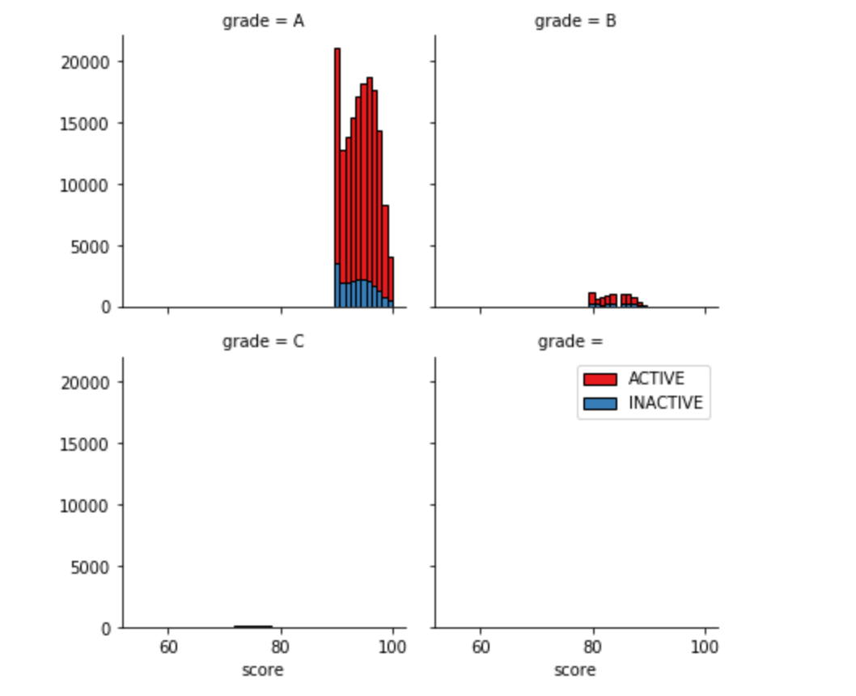
The meaning of grades:
Most restaurants graded with A remain active

Slide 5
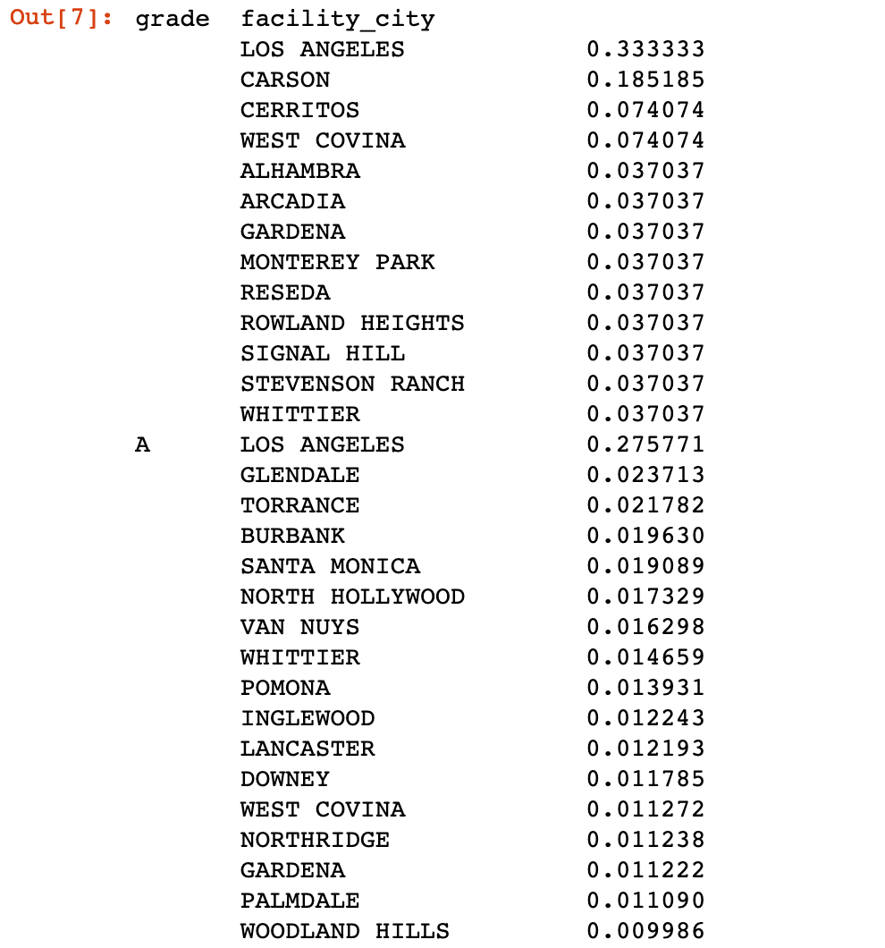
Among all the cities, Los Angeles has most restaurants graded as A. The city contains 33.33% of ‘A’ restaurants in the LA county

Slide 6
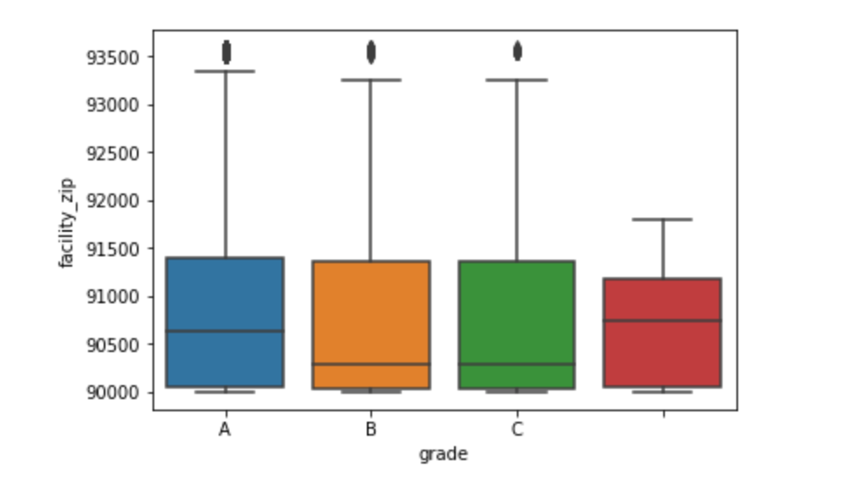
The relationship between restaurant’s location (zip code) and grade

Slide 7
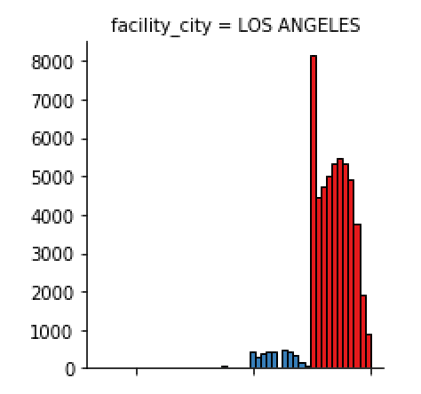
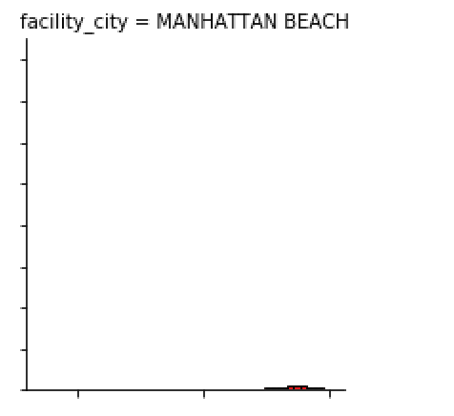
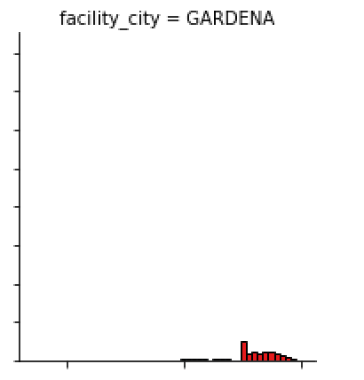
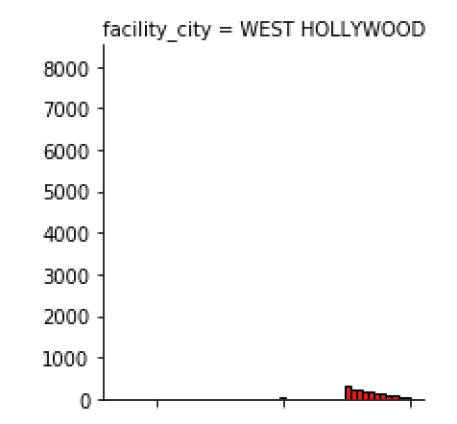
I explored the grades of restaurants in each city.
Among 443 cities, Los Angeles has most high-graded restaurants.

Slide 8
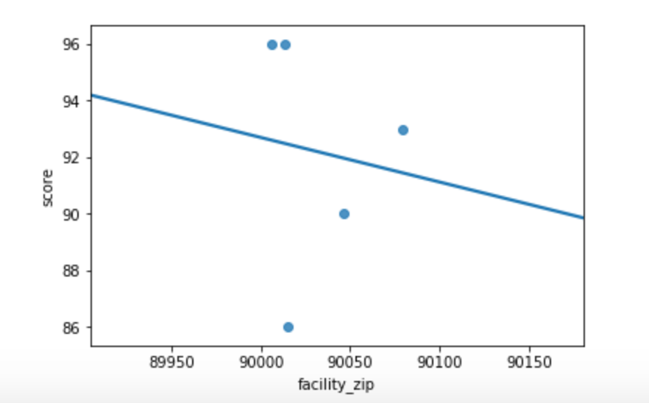
I focus on restaurants in the city of Los Angeles.
From the regression, we can tell restaurants with lower zip codes tend to be safer.

